Slide 1
Chapter 2: High-Level Languages
Programming Tools
Compilers
Assemblers
Interpreters
Notes:
This presentation is on Programming Tools.
It will present a high level look at Compliers, Assemblers and Interpreters.

Slide 2
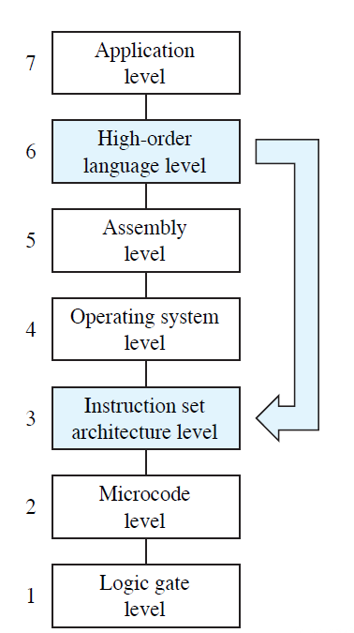
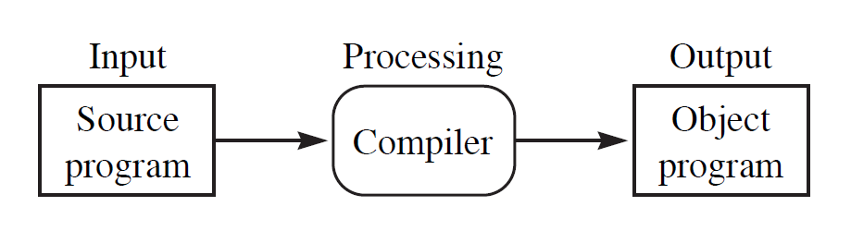
Compilers
Compilers
Translate Level 6 Languages into an equivalent program at a lower level of abstraction
Notes:
Programming tools carry out the mechanics of software creation within the confines of the operating system and hardware environment.
Let’s start with compliers.
Compilers translate Level 6 Languages into an equivalent program at a lower level of abstraction.
The input is the Source Program, the Compiler does the processing and the Output is the Object Program.

Slide 3
Compilers
Most compilers do this translation in a six-phase process
1. Lexical analysis extracts tokens, e.g., reserved words and variables.
2. Syntax analysis (parsing) checks statement construction.
3. Semantic analysis checks data types and the validity of operators.
Notes:
*
Compilers bridge the semantic gap between the higher level language and the machine’s binary instructions.
Most compilers do this translation in a six-phase process.
The first three are analysis phases:
1. Lexical analysis extracts tokens, e.g., reserved words and variables.
2. Syntax analysis (parsing) checks statement construction.
3. Semantic analysis checks data types and the validity of operators.

Slide 4
Compilers
4. Intermediate code generation creates three address code to facilitate optimization and translation
5. Optimization creates assembly code while taking into account architectural features that can make the code efficient.
6. Code generation creates binary code from the optimized assembly code.
Compilers can be written for various platforms by rewriting only the last two phases
Notes:
*
The last three compiler phases are synthesis phases:
4. Intermediate code generation creates three address code to facilitate optimization and translation.
5. Optimization creates assembly code while taking into account architectural features of the machine and the operating system that can make the code efficient.
6. Code generation creates binary code from the optimized assembly code.
Through this modularity, compilers can be written for various machines and operating systems by rewriting only the last two phases.

Slide 5
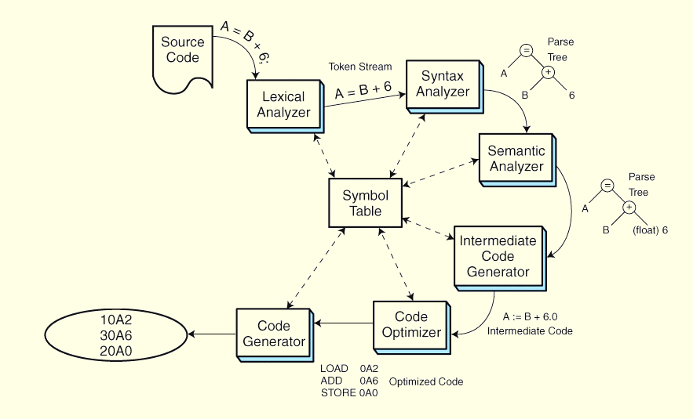
Compilers
Notes:
*
This slide shows this process schematically or as an abstraction.
You can see the path that the starts with the Source Code and finishes with Hexadecimal Code.
Each Phase refers to the Symbol Table.

Slide 6
Interpreted Languages
Interpreters produce executable code from source code in real time
Slower than compiled languages
Less opportunity for error checking
Very useful for teaching programming concepts
Feedback is nearly instantaneous
Performance is rarely a concern
Notes:
*
Interpreters produce executable code from source code in real time, one line at a time.
Consequently, this not only makes interpreted languages slower than compiled languages , however they have less opportunity for error checking.
Interpreted languages are, however, very useful for teaching programming concepts, because feedback is nearly instantaneous, and performance is rarely a concern.

Slide 7
8.4 Assemblers
Assemblers
Simplest of all programming tools
Translate mnemonic instructions to machine code
Most assemblers do this in two passes
First pass partially assembles the code and builds the symbol table
Second pass completes the instructions by supplying values stored in the symbol table.
Notes:
*
Assemblers are the simplest of all programming tools. They translate mnemonic instructions to machine code.
Most assemblers carry out this translation in two passes over the source code.
The first pass partially assembles the code and builds the symbol table
The second pass completes the instructions by supplying values stored in the symbol table.

Slide 8
Assemblers
Output of most assemblers is a stream of relocatable binary code.
Operand addresses are relative to where the operating system chooses to load the program
Absolute (nonrelocatable) code is most suitable for device and operating system control programming
When loaded, special registers provide a base address
Addresses are interpreted as offsets from the base address
Notes:
*
The output of most assemblers is a stream of relocatable binary code.
In relocatable code, operand addresses are relative to where the operating system chooses to load the program.
Absolute (nonrelocatable) code is most suitable for device and operating system control programming.
When relocatable code is loaded for execution, special registers provide the base addressing.
Addresses specified within the program are interpreted as offsets from the base address

Slide 9
Assemblers
Binding is the process of assigning physical addresses to program
Binding can occur at compile time, load time, or run time.
Compile time binding gives absolute code
Load time binding assigns physical addresses as the program is loaded into memory
Run time binding requires a base register to carry out the address mapping
Notes:
*
The process of assigning physical addresses to program variables is called binding.
Binding can occur at compile time, load time, or run time.
Compile time binding gives us absolute code.
Load time binding assigns physical addresses as the program is loaded into memory.
With load time, binding the program cannot be moved!
Run time binding requires a base register to carry out the address mapping.

Slide 10
Link Editors
Link editors (Linker) take binary instructions and create an executable module
Link editors concatenate various binary routines into a single executable
Link editors perform two passes
First - create a symbol table
Second - resolve references to the values in the symbol table
Notes:
*
On most systems, binary instructions must pass through a link editor (or linker) to create an executable module.
Link editors incorporate various binary routines into a single executable file as called for by a program’s external symbols.
Like assemblers, link editors perform two passes:
The first pass creates a symbol table and the second resolves references to the values in the symbol table.

Slide 11
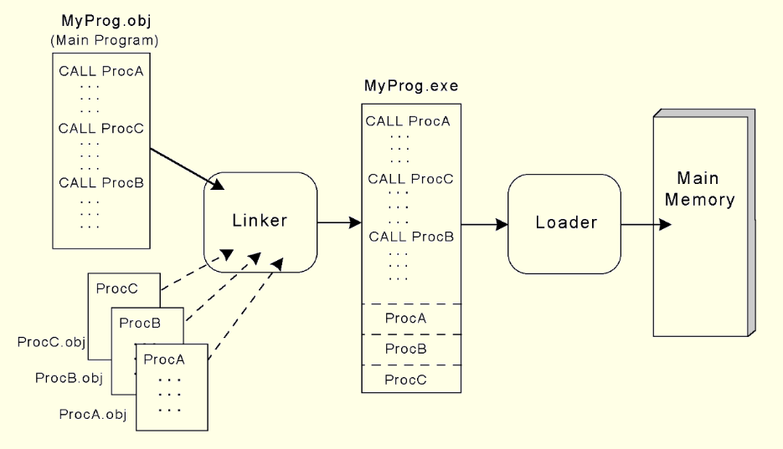
Linkers & Loaders
Notes:
*
This slide shows this process schematically or as an abstraction.
Here you can see the various programs that are fed into the Linker.
The linker creates an executable file.
Finally, the loader adds addresses to the code and places it into Memory.
Did you know that all that was going on behind the scenes when you write a program?

Slide 12
Dynamic Linking
Dynamic linking delays link editing until load time or run time
External modules are loaded from dynamic link libraries (DLLs)
Load time dynamic linking
Slower program loading
Calls DLLs faster
Run time dynamic linking
External module is called first
Slower execution time
Smaller program
Programmer may not control DLL
*
Notes:
*
Dynamic linking is when the link editing is delayed until load time or at run time.
External modules are loaded from from dynamic link libraries (DLLs).
Load time dynamic linking slows down program loading, but calls to the DLLs are faster.
Run time dynamic linking occurs when an external module is first called, causing slower execution time.
Dynamic linking makes program modules smaller, but carries the risk that the programmer may not have control over the DLL.

Slide 13
Programming Tools
High Level Languages
Problem solving tools that are closer to how people think
Many layers from how the machine implements the solution
Notes:
*
High Level Languages provide problem solving tools that are closer to how people think, however they are many layers away from how the machine implements the solution.
This can cause problems in execution for a program that is syntactically and semantically correct.
Keep this in mind as we explore the lower levels of Computer Systems.
Remember there are three other Lectures for Chapter 2. Please review them all before doing the quiz.

